Slide 1
Opportunity Identification
Teaching materials to accompany:
Product Design and Development
Chapter 3
Karl T. Ulrich and Steven D. Eppinger
5th Edition, Irwin McGraw-Hill, 2012.
Many of the graphics shown here are from Innovation Tournaments by Christian Terwiesch and Karl T. Ulrich (Harvard Business Press, 2009).

Slide 2

Product Design and Development
Karl T. Ulrich and Steven D. Eppinger
5th edition, Irwin McGraw-Hill, 2012.
Chapter Table of Contents:
Introduction
Development Processes and Organizations
Opportunity Identification
Product Planning
Identifying Customer Needs
Product Specifications
Concept Generation
Concept Selection
Concept Testing
Product Architecture
Industrial Design
Design for Environment
Design for Manufacturing
Prototyping
Robust Design
Patents and Intellectual Property
Product Development Economics
Managing Projects

Slide 3
Opportunity
Horizon 1: improvements, variants, and cost reduction of existing one.
Horizon 2: new territory of one or both of the market and technology dimensions.
Horizon 3: New category of product/service with great uncertainty.

Slide 4
Opportunity identification process
Establish a charter
Generate and sense many opportunities
Screen opportunities
Develop promising opportunities
Select exceptional opportunities
Reflect on the result and process.

Slide 5
Techniques for generating opportunities
Follow a personal passion
Compile bug lists
Pull opportunities from capabilities (resources).
  Valuable, rare, not easy to imitate, non-substitutable.
Study customers
Consider implications of trends
Imitate but improve.
Mind your internal sources.

Slide 6
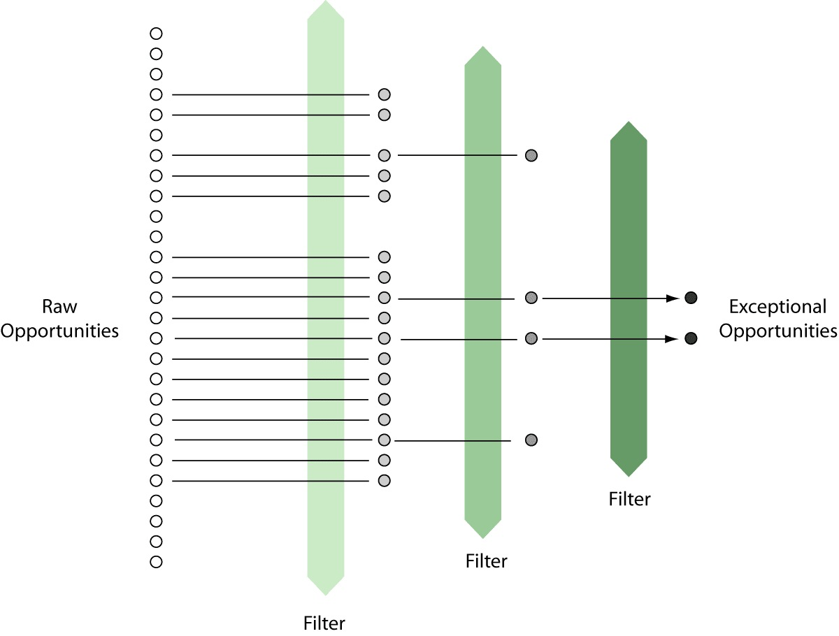
Opportunities Begin the Product Planning and Product Development Processes
Opportunity Tournament
Exceptional Opportunities
Planning
Concept
Development
System-Level
Design
Detail
Design
Testing and
Refinement
Production
Ramp-Up

Slide 7
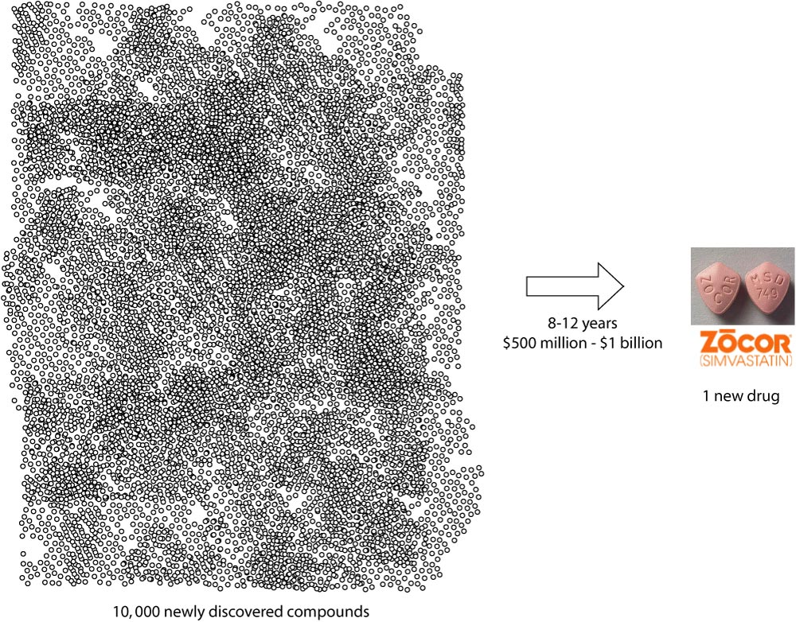
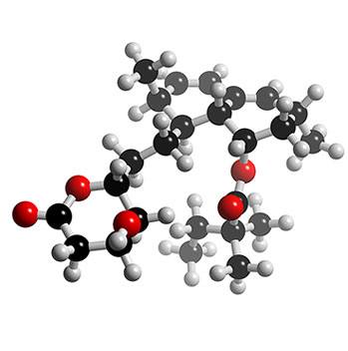
Pharmaceutical Drug Development

Slide 8
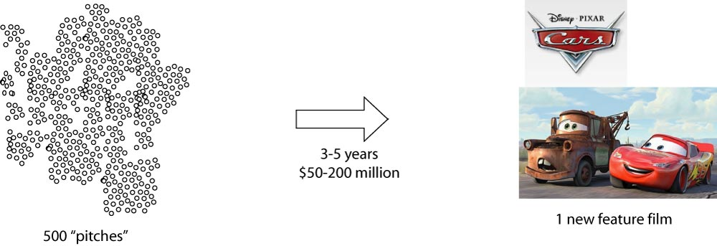
Hollywood Film Studios

Slide 9
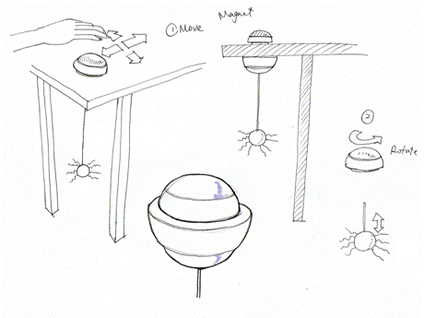
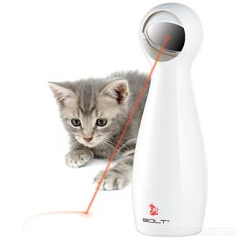


Opportunity Identification Example

Slide 10
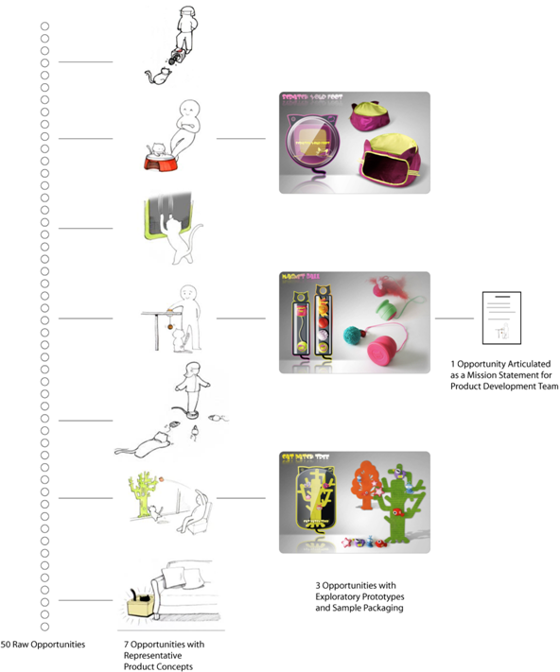

FroliCat Sway Opportunity Funnel
1
mission statement
1
PD process
1
product launch
3
explored
50 opportunities
7
selected

Slide 11
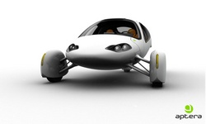
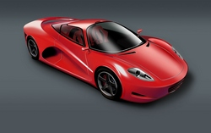
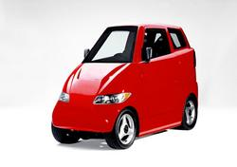
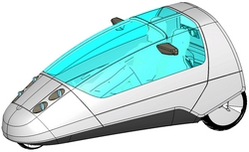
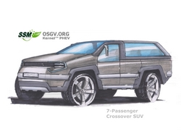
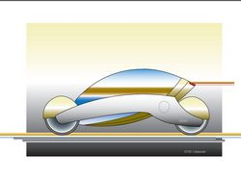
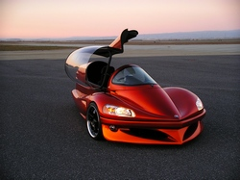
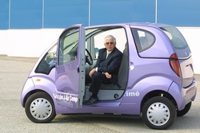
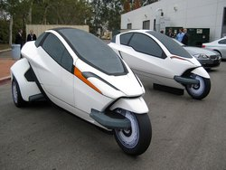
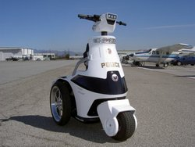

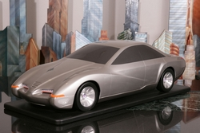
Automobile Concepts

Slide 12

Source: Lunar Design

Slide 13
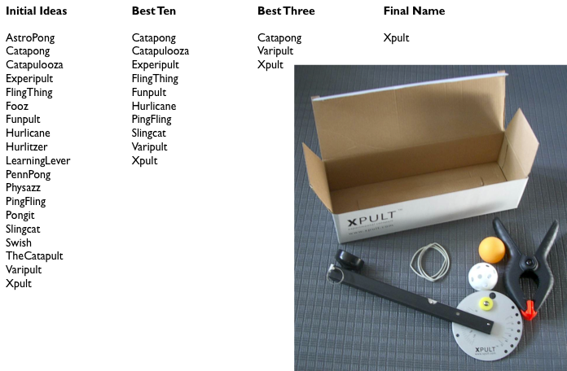
Product Naming Tournament

Slide 14
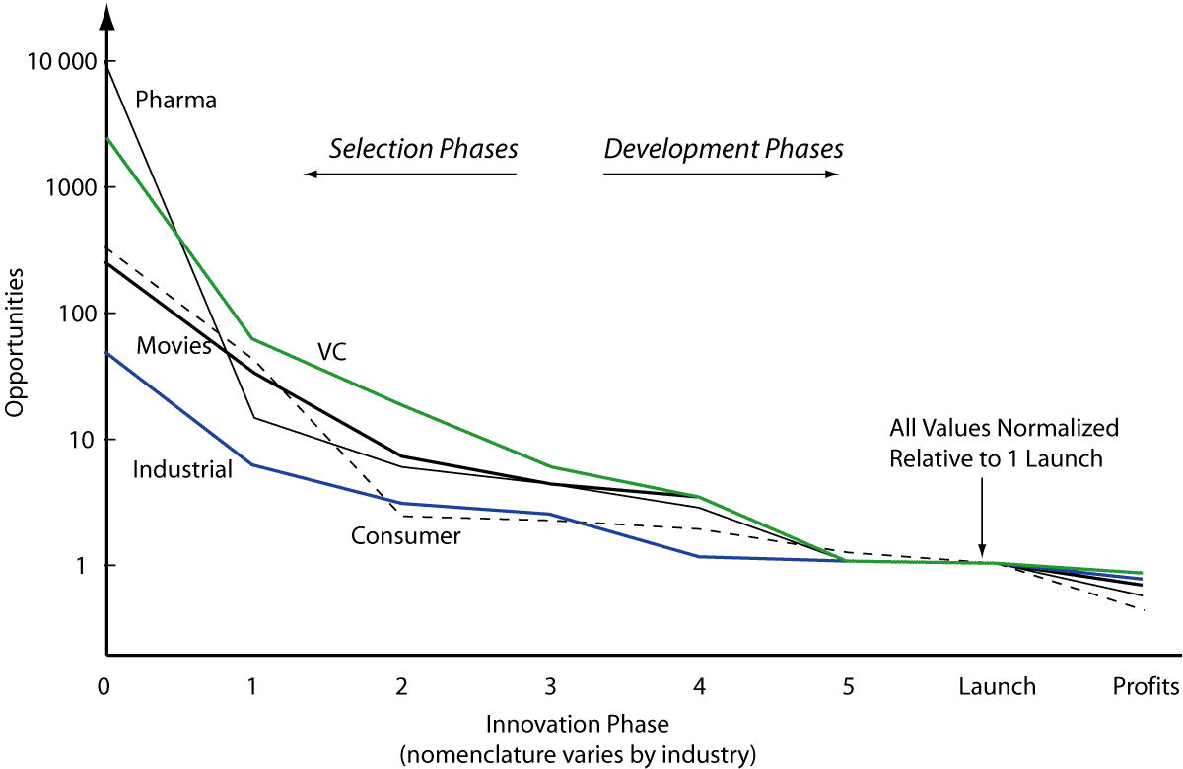
The Funnel in Various Industries

Slide 15
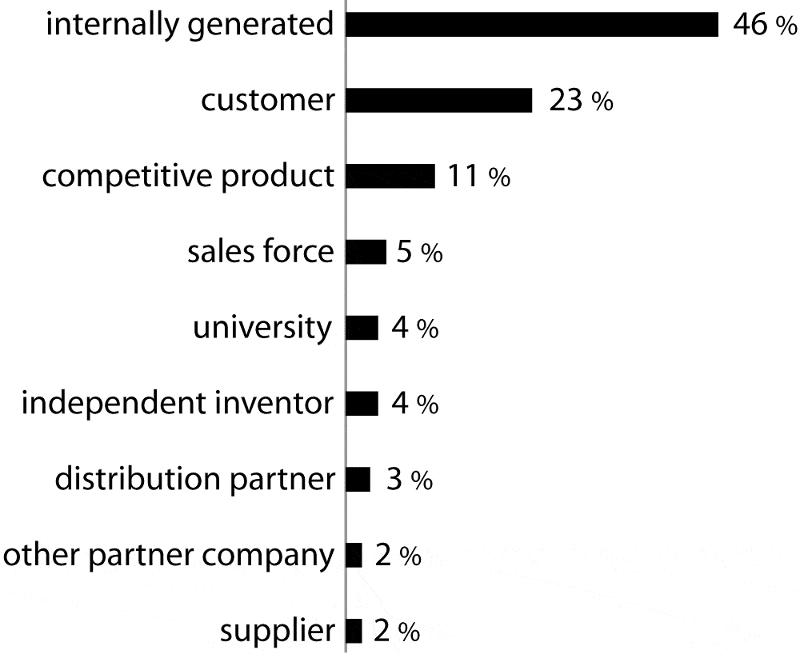
Where do opportunities come from?
Source:
Terwiesch and Ulrich survey of 524 managers in diverse service and product industries, October 2006.

Slide 16
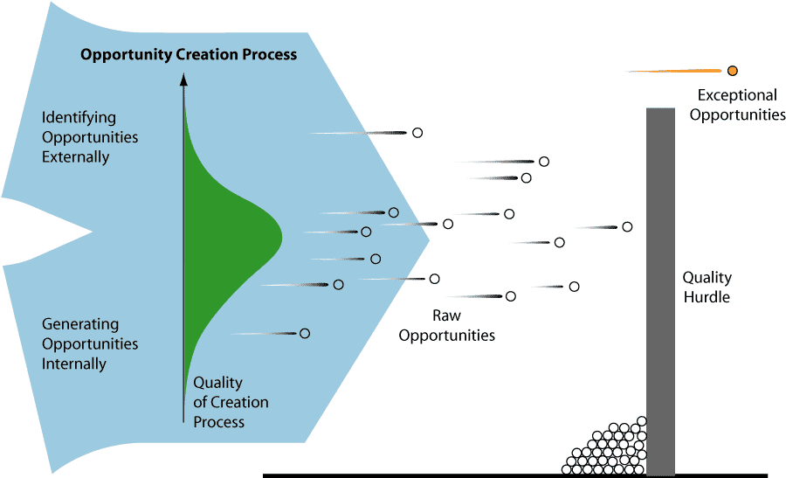
What drives the quality of the opportunities?
Mean quality of the opportunity identification process.
Variance in quality of the opportunity identification process.
Number of “draws” from the opportunity identification process.
Accuracy of discerning the best subset of opportunities generated.

Slide 17
Quality of opportunities
Is there a real market and a real product?
Can we win?
It is worth doing it?

Slide 18
Project Down selection:
The PD Process Funnel
Planning
Concept
Development
System-Level
Design
Detail
Design
Testing and
Refinement
Production
Ramp-Up

